Slide 1
Revocability and Irrevocability
Richard Warner
​

Slide 2
Revocation
The traditional rule: an offer can be revoked anytime prior to acceptance.
The modern law limits this rule through rules about irrevocability.

Slide 3
Walking Across the Bridge
I say, "I offer to pay you $100 to walk across the bridge now". I don't want you to promise to walk across the bridge. I want you to do it--my offer is an offer to pay for the performance.
You cannot accept this by saying "I accept"--that would be to promise to walk across, and that is not what I am asking for.
The only way to accept the offer is to walk across the bridge.
You start walking. You have not yet accepted. Accepting is walking all the way.
When you are halfway across, I shout, “I revoke.” Under the traditional rule, did I revoke my offer?
(a) Yes
(b) No

Slide 4
Pettersen v. Pattberg
What was the offer? To let Petterson pay off the mortgage in advance for $780 less than the total amount.
  Like the bridge example, this is an offer than must be accepted by performance
As Pattberg knows, Petterson will need some time to raise enough money.
  So Pattberg expects Pettersen to rely on the offer. Indeed, inducing that reliance was one point of making the offer.
Petterson raises the money, comes to Pattberg’s house, but, before Petterson can put the money in his hands (and so accept the offer by performance), Pattberg says, “I have sold the mortgage to another.”
  That is a revocation (an announcement from a reliable source that the offeror is no longer in a position to perform).
  It occurred before acceptance. So the court says it the offer was revoked.

Slide 5
A Snare And A Delusion?
The dissent argues that the offer is nothing but a "snare and a delusion" unless there is some assurance that it will not be withdrawn.
The argument is that to get into a position to accept the offer, Petterson has to rely on it. He has to raise the money. If the offer is supposed to be an incentive toward such reliance, the court should not allow it to be withdrawn before Petterson has a chance to accept.

Slide 6
Drennan v. Star Paving Co.
This is a mistaken bid case. It is the typical scenario: a subcontractor makes a mistake in his bid--it is too low by about $8,000; the general contractor uses this bid in figuring his costs, and the general's bid is the lowest.
After the general's bid has been accepted, the sub discovers his mistake and refuses to perform.
The general is going to perform that contract; he wants to hold the sub to his contact with him. It is the sub that wants out of that contract.

Slide 7
The Sub’s Argument
The sub argues that he can get out because the general had not accepted the offer before the sub revoked it.
Is the sub right?
  There was no promissory acceptance, no acceptance by saying "I accept".
  There was no acceptance by performance. The general’s performance would be paying the sub for work done, and that did not happen.
So can the sub revoke before acceptance?

Slide 8
The Court Says No
The court applies the doctrine of promissory estoppel. It quotes 1st Restatement:
    A promise is binding which the promisor
    (1) should reasonably expect to induce reliance of a definite and substantial character;
    (2) which does induce such reliance;
    (3) which it would be unjust not to enforce.
The court notes that "Defendant [sub] has reason not only to expect plaintiff [general] to rely on its bid but to want him to."

Slide 9
The Second Restatement On This Point
§87(2) rewrites the promissory estoppel doctrine for offers.
An offer which [1] the offeror should reasonably expect to induce action or forbearance of a substantial character on the part of the offeree before acceptance and [2] which does induce such action or forbearance is [3] binding as an option contract to the extent necessary to avoid injustice.
For the exam, replace (3) with “is irrevocable for a reasonable amount of time.”

Slide 10
Why Binding As An Option Contract?
An option contract is a promise to hold an offer open for a specified time.
  Note: “Here is my offer. I intend to hold it open until Friday” is NOT an option contract. “I intend” is typically not enough to create a promise.
Consider the bridge case. You say I revoke. I stop walking. Is there consideration for your promise to pay?
  Is there a breach of the contract to pay for walking across the bridge? No.
  Same problem in Pattberg. Not clear Pattberg ever accepted.

Slide 11
Cleaning My Office, 1
I want you to clean my office. I am leaving for a meeting and will not be back until the end of the day. As you know: (1) I don't care when you clean it as long as it gets done by the end of the day, and (2) you are also the only person I am going to ask. As I am leaving, I say to you, "I'll pay you $50 to clean up my office." You don't accept or reject my offer right away. You want to look at my office and see how messy it is. I say, “OK.” I leave and you go look at my office. You decide $50 is a good price and clean it up. When I come back can I revoke my offer on the ground that you never accepted it?
(a) Yes
(b) No

Slide 12
Cleaning My Office, 2
I want you to clean my office. I say to you, "I'll pay you $50 to clean up my office." You know: I am going to class in a hour, and I tell you that, if you decide not to do it, I'll make an announcement in class and hire someone else.
Requires a promissory acceptance.
The offer terminated when I went to class—only is open until I go.
As I am leaving, You say you want to think about it, and go away. I don't hear from you before I have to go to class. While I'm in class you clean my office, but by the end of class I have hired someone else. Can I revoke the offer on the ground that you never accepted?
(a) Yes
(b) No

Slide 13
Cleaning My Office, 3
I want you to clean my office. I am leaving for a meeting and will not be back until the end of the day. As you know: (1) I don't care when you clean it as long as it gets done by the end of the day, and (2) you are also the only person I am going to ask.
As I am leaving, I say to you, "I'll pay you $50 to clean up my office. Accept by promise or performance." You don't accept or reject my offer right away. You want to look at my office and see how messy it is. I say, “OK.” I leave and you go look at my office. You decide $50 is a good price and clean it up. When I come back, you are in the middle of cleaning my office. Can I revoke my offer on the ground that you never accepted it?
No.

Slide 14
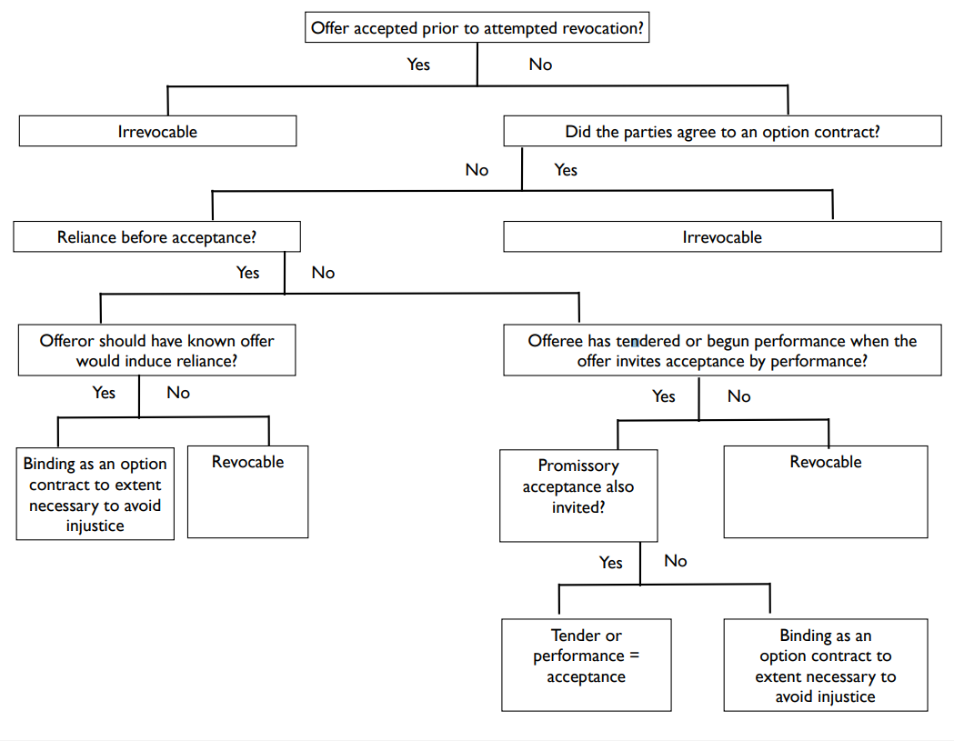
Pattberg
Bridge example
Cleaning office, 3

