Slide 1
The Proof Requirement
Richard Warner

Slide 2
The Rule
You must prove damages reasonable certainty.
Don’t prove your damages with reasonable certainty, you don’t get them.
Some cases where courts—as a matter of law—held you can’t prove damages with reasonable certainty.

Slide 3
Rombola v. Cosindas
The promise: “By the terms of a written contract with Cosindas, Rombola agreed to train, maintain and race Cosindas’s [horse] Margy Sampson . . . for the period November 8, 1962, to December 1, 1963.”
The breach: “On October 25, 1963 . . . Cosindas . . . took possession of the horse at Suffolk Downs and thereby deprived Rombola of his right to race the horse. The horse did not race between October 25 and December 1, 1963.”
Evidence of loss: “In the year of the contract, of the twenty-five races in which the horse was entered by Rombola, she had won ten and shared in the purse money in a total of twenty races, earning, in all, purses approximating $12,000. In the year following the expiration of Rombola's contract with Cosindas, the horse raced twenty-nine times and won money in an amount almost completely consistent percentagewise with the money won during the period of the contract.” A track record

Slide 4
The Court’s Decision
“In determining the amount of damages to be awarded, mathematical accuracy of proof is not required. . . . The likelihood of prospective profits may be proved by an established earnings record. . . . Expert opinion may be introduced to substantiate the amount of prospective profits.”

Slide 5
The Old New Business Rule
The old—no longer the law—rule: as a matter of law, one cannot prove the lost profits from a new business with reasonable certainty.
This is clearly a bad rule.
There is evidence on can have.

Slide 6
Loss of Goodwill
Some jurisdictions hold that you cannot prove lost profits from loss of goodwill with reasonable certainty.

Slide 7
The reasonable certainty requirement
Some typical situations
Commercial
Non-commercial
New business
Evidence of lost profits goes to the jury
Own “track record” Other’s ”track record”
Intermediary-reseller
Lost profits typically easy to calculate
Contract basis for prediction
Manufacturer-buyer
Can be problematic to calculate lost profits from failure to deliver goods necessary for manufacturing process
Loss of goodwill
Some courts have held loss of goodwill damages cannot, as a matter of law, be proven with reasonable certainty

Slide 8
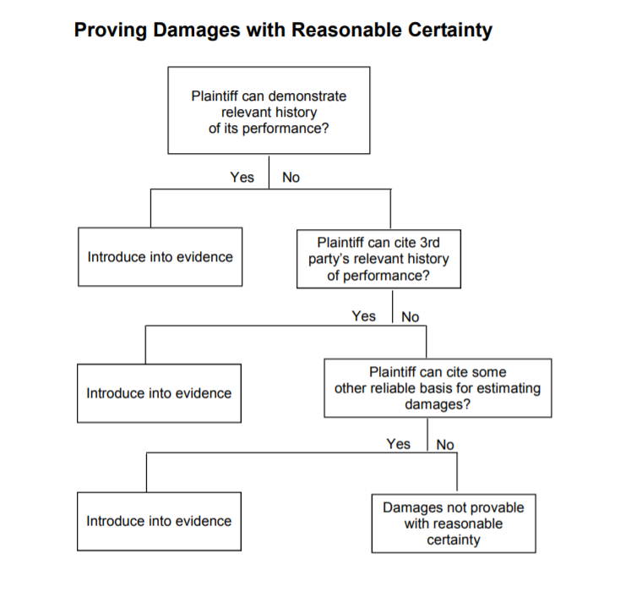

Slide 9
Expectation /Mitigation
Proof problems (but money damages adequate)
Money damages inadequate (perhaps the result of proof problems)
Reliance
Return items equitable?
Specific Performance
Material breach requirement
Restitution
Rescission

