Slide 1
Impracticability and Frustration
Richard Warner

Slide 2
Excuse of performance
Material breach
Failure of condition
Events
Uncertainty
Unforeseen future event
Mistake about past event
Commercially impracticable
Performance pointless
Basic assumption
Threshold conditions
Who ought to bear the loss?

Slide 3
Impracticability Doctrine
A party seeking excuse on the basis of impracticability must show:
(1) that an event, unforeseen at the time of contracting, rendered performance commercially impracticable, and
(2) that the party ought not to bear the loss caused by the event.
Who has or is in a better position to get information relevant to avoiding the loss? [You are looking for a difference between the parties.]
Who is in a better position to take steps to avoid the loss?

Slide 4
Transatlantic v. United States
The US hired Transatlantic to ship wheat to Iran.
The main route to Iran is through the Mediterranean Sea to the Suez Canal.
After Transatlantic had set sail, the Iranians closed the Suez Canal (in a dispute with the British).
Transatlantic took the longer route around the Cape of Good Hope. Additional cost = $43,972.
There was no breach of contract: Transatlantic and the US both performed their obligations.

Slide 5
Restitution Available?
Transatlantic would like to sue in restitution. It would like to argue that
it conferred a benefit on the US—delivering the wheat, valued at the contract price + $43,972, and that is unjust to let the US retain that benefit.
But as long as the contract is enforceable, restitution is unavailable.
(a) True
(b) False

Slide 6
Material Breach
Can Transatlantic plausible argue that there was a material breach?
(a) Yes
(b) No

Slide 7
Transatlantic’s Idea
Argue that impracticability excuses its obligation to deliver the wheat.

Slide 8
An Event Unforeseen At the time of Contracting
Was the closure of the canal unforeseen at the time of contracting?
“We know or may safely assume that the parties were aware, as were most commercial men with interests affected by the Suez situation, . . . that the Canal might become a dangerous area. No doubt the tension affected freight rates, and it is arguable that the risk of closure became part of the dickered terms . . . We do not deem the risk of closure so allocated, however. Foreseeability or even recognition of a risk does not necessarily prove its allocation. Parties to a contract are not always able to provide for all the possibilities of which they are aware, sometimes because they cannot agree, often simply because they are too busy.”

Slide 9
Commercially Impracticable?
Performance is commercially impracticable when it is excessively difficult or excessively expensive.
How difficult or expensive? There is no clear standard or guidance.
Performance was not particularly difficult in Transatlantic. It just took longer. It was expensive.

Slide 10
Who Ought to Bear the Loss?
Ask: who is in a better position to have information about that?
A company whose business is international shipping?
Or, United States Department of Agriculture?
Who is in a better position to take steps to avoid the loss?
Note the parallel with the Hadley rule.

Slide 11
Impracticability Doctrine As Stated in Transatlantic
An unforeseen event must make performance commercially impracticable ( = roughly, difficult and/or expensive), and
The party seeking excuse must show that it ought not to bear the loss caused by the unforeseen event.
Assignment of risk of loss implied
Risk of loss explicitly assigned in the contract
Risk of loss assigned by custom
Parties really did have an implied understanding
Parties did not really have an implied understanding

Slide 12
Sally is negotiating the purchase of a condo. The condos are under construction; the architect and developer is Ed, and this project is his first construction project. Sally and Ed sign a written contract under which Sally agrees to purchase and Ed agrees to build the condo and transfer ownership to Sally in six months. About a month later, Ed discovers that the four-story condo structure he designed and is building violates city zoning ordinances. In a completely unexpected move, the city passed an ordinance that limits condo buildings to three stories in the particular residential area in which Ed is building. The city passed this ordinance just before Ed started building, and Ed was unaware of it. It takes Ed three months to secure a variance from the zoning regulations that allows him to construct his four-story building. There is no way he could have gotten it faster. As a result, he is two months late completing Sally’s unit.
Was the zoning ordinance change unforeseen at the time of contracting?
(a) Yes
(b) No

Slide 13
Sally is negotiating the purchase of a condo. The condos are under construction; the architect and developer is Ed, and this project is his first construction project. Sally and Ed sign a written contract under which Sally agrees to purchase and Ed agrees to build the condo and transfer ownership to Sally in six months. About a month later, Ed discovers that the four-story condo structure he designed and is building violates city zoning ordinances. In a completely unexpected move, the city passed an ordinance that limits condo buildings to three stories in the particular residential area in which Ed is building. The city passed this ordinance just before Ed started building, and Ed was unaware of it. It takes Ed three months to secure a variance from the zoning regulations that allows him to construct his four-story building. There is no way he could have gotten it faster. As a result, he is two months late completing Sally’s unit.
Did the zoning ordinance make performance commercially impracticable?
(a) Yes
(b) No

Slide 14
Sally is negotiating the purchase of a condo. The condos are under construction; the architect and developer is Ed, and this project is his first construction project. Sally and Ed sign a written contract under which Sally agrees to purchase and Ed agrees to build the condo and transfer ownership to Sally in six months. About a month later, Ed discovers that the four-story condo structure he designed and is building violates city zoning ordinances. In a completely unexpected move, the city passed an ordinance that limits condo buildings to three stories in the particular residential area in which Ed is building. The city passed this ordinance just before Ed started building, and Ed was unaware of it. It takes Ed three months to secure a variance from the zoning regulations that allows him to construct his four-story building. There is no way he could have gotten it faster. As a result, he is two months late completing Sally’s unit.
Who has better information about zoning ordinances?
(a) Ed
(b) Sally

Slide 15
Sally is negotiating the purchase of a condo. The condos are under construction; the architect and developer is Ed, and this project is his first construction project. Sally and Ed sign a written contract under which Sally agrees to purchase and Ed agrees to build the condo and transfer ownership to Sally in six months. About a month later, Ed discovers that the four-story condo structure he designed and is building violates city zoning ordinances. In a completely unexpected move, the city passed an ordinance that limits condo buildings to three stories in the particular residential area in which Ed is building. The city passed this ordinance just before Ed started building, and Ed was unaware of it. It takes Ed three months to secure a variance from the zoning regulations that allows him to construct his four-story building. There is no way he could have gotten it faster. As a result, he is two months late completing Sally’s unit.
Who was in a better position to take steps to avoid the delay from the change in the zoning ordinance?
(a) Ed
(b) Sally

Slide 16
Tony
Tony Tenor signs a contract with a movie company for the part of "Mad Dog" in the movie "Malibu Invasion of the Frat Boys", a comedy set in Malibu. In the contract, Tony agrees to gain 50 pounds--since the part calls for him to be fat, and he also agrees to learn to speak without his strong New York accent. Tony hires a nutritionist and a speech therapist, and succeeds in gaining weight and losing his accent. However, the company never makes the movie since the city of Malibu denies it a permit to film in Malibu. The day before the company applied for the permit, the Malibu City Council passed very stringent requirements for issuing such permits. Films showing Malibu have to be "consistent with the image of Malibu as a dignified and quiet upper class community." The Council held that "Invasion of the Frat Boys" was not consistent with this image. The movie industry had been aware for some time that Malibu might pass such a regulation, but no one knew when those councilpersons in favor of the requirement would secure enough votes to make it pass. No one disputes that the scenery of Malibu is essential to the film, and that the film is certain to be a box office disaster unless it is filmed in Malibu. Does impracticability doctrine excuse the movie company?
(a) Yes
(b) No

Slide 17
The Brewery
The architect hired to design and construct a brewery discovers, after entering the contract, that the ground at the brewery site is particularly soft and hence that much more excavation and foundation work will be required. This greatly increases the cost of construction. The architect claims that impracticability excuses her performance. Can you add facts to support the architect’s claim? Assume that the risk of loss from the soft ground is not allocated to either party by the contract or by custom.

Slide 18
Sowle and Marvell
Steve Sowle owns and manages Vegetable Sowle, a restaurant. He is negotiating with the poet and master chef Andrew Marvell to be the celebrity chef for a special event Sowle is planning called World Enough and Time: Vegetables with Soul. “It’s going to be big,” Sowle says, “Vaster than empires!” Sowle knows that Marvell runs a Brussel sprout farm, and that he can supply top quality sprouts. They enter into a contract for Marvell to supply his “top quality” sprouts for the event.
Marvell grows Brussel sprouts on his farm in Monterey County, California. Unfortunately, before Marvell can harvest the sprouts to send them to Sowle a small private plane, suffering from engine trouble and very far off course (planes do not normally fly over his fields) crashes into his fields and destroys his top quality sprouts. There is no other source of sprouts as good as Marvell’s top quality sprouts.
Does the destruction of the sprouts excuse Marvell from delivering them to Sowle under impracticability doctrine?
(a) Yes
(b) No

Slide 19
Frustration Doctrine
A party seeking excuse on the basis of frustration must show:
(1) that an event, unforeseen at the time of contracting made performance lose its essential point, and
(2) that the party ought not to bear the loss caused by the event.

Slide 20
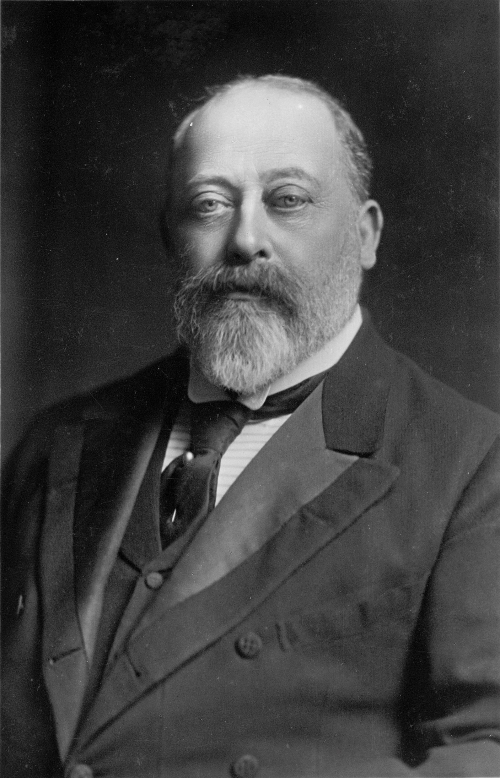
Krell v. Henry
Henry wanted to watch the coronation parade of King Edward VII.
Krell’s flat overlooked the parade route. Henry rented the flat for June 26 (the parade day) and 27 for £75 (£9000+ in 2020).
After they entered the contract, the parade was canceled (Edward had appendicitis).

Slide 21
Commercially Impracticable?
Assume the cancelation was unforeseen at the time of contracting.
The contract is to rent a flat on a certain day—not a contract to rent a flat to watch the parade.
Did the cancellation make performance commercially impracticable?
(a) Yes
(b) No

Slide 22
Who Ought To Bear The Loss?
Assume performance loses its essential point.
The information and control approach does not help much here.
The parties has the same information about the parade (the announcement of the date), and neither party was in a position to prevent or cure King Edward’s appendicitis.

Slide 23
Another Approach
Enforce
Not enforce
Krell gets rent twice
Rents it again when parade rescheduled
Henry pays for nothing
Krell no worse off than if parade had not been canceled
Rents again when the parade is rescheduled
Henry does not pay for nothing
Which option do you think is better?

Slide 24
America’s Cup
I, the builder, contract with you to build a sailboat for the America's Cup. The cost of construction is $10,000,000. Just before the boat is completed, the America's Cup is canceled. You, the buyer, argue that you do not have to honor the contract because your performance is now pointless; you argue that frustration of purpose excuses you. Are you correct?
(a) Yes
(b) No

Slide 25
A Krell v. Henry-Like Approach
Enforce
Not enforce
Builder gets paid
Not clear the builder gets paid twice
Buyer gets the boat.
Does not pay for nothing.
Builder not no worse off than if Cup had not been canceled.
Builder bears a big loss.
Buyer does not have to pay.
There is a significant loss to allocate. Who ought to bear it?

Slide 26
Tony
Tony Tenor signs a contract with a movie company for the part of "Mad Dog" in the movie "Malibu Invasion of the Frat Boys", a comedy set in Malibu. In the contract, Tony agrees to gain 50 pounds--since the part calls for him to be fat, and he also agrees to learn to speak without his strong New York accent. Tony hires a nutritionist and a speech therapist, and succeeds in gaining weight and losing his accent. However, the company never makes the movie since the city of Malibu denies it a permit to film in Malibu. The day before the company applied for the permit, the Malibu City Council passed very stringent requirements for issuing such permits. Films showing Malibu have to be "consistent with the image of Malibu as a dignified and quiet upper class community." The Council held that "Invasion of the Frat Boys" was not consistent with this image. The movie industry had been aware for some time that Malibu might pass such a regulation, but no one knew when those councilpersons in favor of the requirement would secure enough votes to make it pass. No one disputes that the scenery of Malibu is essential to the film, and that the film is certain to be a box office disaster unless it is filmed in Malibu. Does frustration doctrine excuse the movie company?
(a) Yes
(b) No

