Slide 1
Liquidated Damages Clauses
Richard Warner

Slide 2
Liquidated Damages Clauses
A clause in a contract is a liquidated damage clause when liquidating damages is its essential purpose.
Liquidate = determine the precise amount.

Slide 3
Black Letter Law
A liquidated damages clause is enforceable when: actual expectation damages were not readily ascertainable at the time of contracting, and:
Either:
(1) The LDC is a reasonable estimate of damages, estimate made at the time of contracting;
or:
(2) The amount in the clause is reasonable proportionable to the actual damages as determined at the time of the trial.
But not both.
Cases split between (1) and (2). (1) is a more lenient--more likely to enforce--attitude toward LDCs.

Slide 4
Hostility toward Liquidated Damages?
You will read that courts have a hostile attitude toward liquidated damages clauses.
Historically, that may be true. It would explain the existence of special rules to evaluate such clauses.
See if you think modern courts are hostile toward liquidated damage clauses after we discuss Truck Rent-A-Center.

Slide 5
Truck Rent-A-Center
Puritan Farms leased 25 new milk delivery trucks from Truck Rent-A-Center for use in th home delivery market.
Milk trucks are highly specialized
Milk storage
Cooling systems
Frequent stops

Slide 6
Estimating Expectation Damages
Puritan farms could breach the lease by not renting the trucks full term.
Problems estimating expectation damages at the time of contracting:
Mitigation possibilities are uncertain:
Re-rental market is uncertain
Condition of the trucks is hard to predict
Location of the trucks could be hard to determine
So expectation damages are difficult to estimate.

Slide 7
Truck-Rent-A-Center
Article 16 of the lease agreement provided that if the agreement should terminate prior to expiration of the term of the lease as a result of the lessee's breach, the lessor would be entitled to damages, "liquidated for all purposes", in the amount of all rents that would have come due from the date of termination to the date of normal expiration of the term less the "re-rental value" of the vehicles, which was set at 50% of the rentals that would have become due. In effect, the lessee would be obligated to pay the lessor, as a consequence of breach, one half of all rentals that would have become due had the agreement run its full course. The agreement recited that, in arriving at the settled amount of damage, "the parties hereto have considered, among other factors, Lessor's substantial initial investment in purchasing or reconditioning for Lessee's service the demised motor vehicles, the uncertainty of Lessor's ability to re-enter the said vehicles, the costs to Lessor during any period the vehicles may remain idle until re-rented, or if sold, the uncertainty of the sales price and its possible attendant loss. The parties have also considered, among other factors, in so liquidating the said damages, Lessor's saving in expenditures for gasoline, oil and other service items."

Slide 8
What Make It Reasonable?
“Looking forward from the date of the lease, the parties could reasonably conclude, as they did, that there might not be an actual market for the sale or re-rental of these specialized vehicles in the event of the lessee's breach. To be sure, plaintiff's lost profit could readily be measured by the amount of the weekly rental fee. However, it was permissible for the parties, in advance, to agree that the re-rental or sale value of the vehicles would be 50% of the weekly rental. Since there was uncertainty as to whether the trucks could be re-rented or sold, the parties could reasonably set, as they did, the value of such mitigation at 50% of the amount the lessee was obligated to pay for rental of the trucks. This would take into consideration the fact that, after being used by the lessee, the vehicles would no longer be "shiny, new trucks", but would be used, possibly battered, trucks, whose value would have declined appreciably. The parties also considered the fact that, although plaintiff, in the event of Puritan's breach, might be spared repair and maintenance costs necessitated by Puritan's use of the trucks, plaintiff would have to assume the cost of storing and maintaining trucks idled by Puritan's refusal to use them.”

Slide 9
Deference to the Parties
The court defers to the parties judgment.
This makes good sense where;
The parties are experienced businesses
The contract shows that they considered relevant factors
And they freely agree to the liquidated damage clause.
Courts that defer to the parties judgment are not hostile toward liquidated damage clauses.

Slide 10
Lake River v. Carborundum
“Carborundum Co. (Carborundum) (defendant) produces Ferro Carbo, which is a powder used in steel manufacturing. Carborundum entered into a distribution contract with Lake River Corp. (Lake River) (plaintiff), under which Lake River would bag the Ferro Carbo in its warehouses and ship it to Carborundum’s customers. Because Lake River had to purchase new equipment to fulfill the agreement, it insisted that Carborundum agree to ship a minimum quantity of Ferro Carbo within three years or pay the difference. Subsequently, demand for steel fell, and Carborundum did not meet the minimum shipments it had guaranteed.”

Slide 11
Mitigation Possibilities
Depending on the circumstances, Lake River might be able to mitigate its damages by bagging ferro carbo for other companies, or by converting its machinery to bag other products.
(a) Yes
(b) No

Slide 12
The Liquidated Damage Clause
“In consideration of the special equipment [i.e., the new bagging system] to be acquired and furnished by LAKE-RIVER for handling the product, CARBORUNDUM shall, during the initial three-year term of his Agreement, ship to LAKE-RIVER for bagging a minimum quantity of [22,500 tons]. If, at the end of the three-year term, this minimum quantity shall not have been shipped, LAKE-RIVER shall invoice CARBORUNDUM at the then prevailing rates for the difference between the quantity bagged and the minimum guaranteed.”
Does this take mitigation possibilities in to account?
(a) Yes
(b) No

Slide 13
Count On Us Computers
You buy a computer from Count on Us Computers. Your contract includes the following liquidated damage clause: If after two attempts to repair any malfunction, Count on Us does not successfully do so, Count on Us shall pay the purchase price to the buyer who gets to keep the computer.
Suppose that Count on Us twice fails to repair a minor problem in the display, a problem that is merely a minor nuisance. What are the damages? Is the clause enforceable? Should it be enforceable?

Slide 14
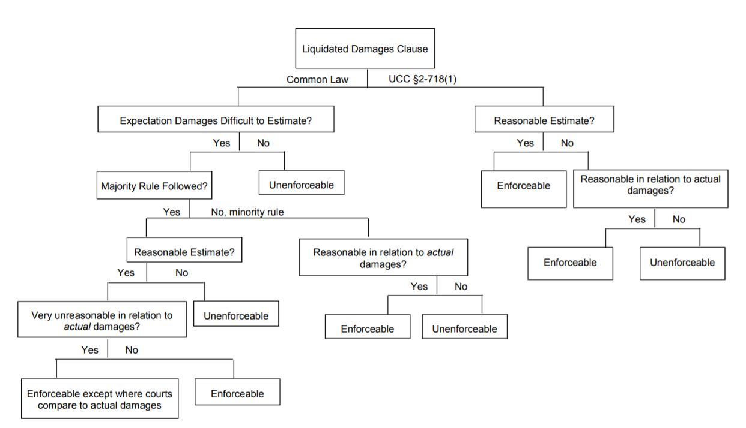

Slide 15
§ 2-718. Liquidation or Limitation of Damages; Deposits.
(1) Damages for breach by either party may be liquidated in the agreement but only at an amount which [1] is reasonable in the light of the anticipated or [2] actual harm caused by the breach, the difficulties of proof of loss, and the inconvenience or nonfeasibility of otherwise obtaining an adequate remedy. A term fixing unreasonably large liquidated damages is void as a penalty.

Slide 16
Passenger v. Airline
This is a contract dispute between a passenger--named, Passenger--and an airline--named, Airline. Passenger held a first class ticket on Airline. Passenger purchased his ticket under a special contract offered only to first class passengers. The contract included this clause:
Liquidated Damage Clause: If there is a delay of over six hours, we will return the full fare plus 10% of the fare for each additional hour over six hours up to a limit of double the full fare.
The flight was overbooked, and Passenger was not allowed to board the plane; this resulted in a delay of twenty-four hours--more than long enough to entitle Passenger to double the fare under the liquidated damage clause, and that is what Passenger sues for. The cost of the ticket is $4000; so Passenger demands $8000. The LCD clause is
(a) enforceable
(b) Is not enforceable

Slide 17
Reliable Construction
Reliable Construction is building a $70 million energy plant. The plant is supposed to generate a minimum of 1,000,000 megawatt hours per year. The contract contains the following clause: If the plant fails to generate the minimum of 1,000,000 megawatt hours per year, Reliable Construction shall forfeit the contract price of $70 million, and will pay for all other damages that are the foreseeable result of the failure to meet the minimum condition. The court that heard this case held the clause was enforceable.
The court must have assumed the plant was worthless if it did not meet the 1,000,000 megawatt requirement.
(a) Yes
(b) No

