Slide 1
Foreseeability (Torts parallel: proximate cause)
Richard Warner

Slide 2
Another Division of Damages
Like mitigation, the foreseeability requirement divides damages between the breacher and the non-breacher.
Unlike mitigation, the requirement focus on what parties know and should do at the time of contracting, not at the time after a breach.

Slide 3
Hadley v. Baxendale
The Hadley brothers owned a mill. The mill shaft broke and the mill shut down. The Hadleys hired the transportation company Pickford & Co. to carry the old shaft to Greenwich, where Messrs. Joyce & Co. would use it as a pattern to make a new shaft.
In a breach of the contract, Pickford & Co delivered the shaft six days late.
The Hadleys claimed damages of £ 251.

Slide 4
Expectation (Without Foreseeability)
Where would the Hadelys be if the promise had been kept?
0 lost profit.
What losses result from the breach?
Six days profit = - £ 251.
Award: £ 251.
The court awards £0.

Slide 5
No Award of Lost Profits
The court says:
Now we think the proper rule in such a case as the present is this: Where two parties have made a contract which one of them has broken, the damages which the other party ought to receive in respect of such breach of contract should be such as may fairly and reasonably be considered either
(1) arising naturally, i.e., according to the usual course of things, from such breach of contract itself, or
(2) such as may reasonably be supposed to have been in the contemplation of both parties, at the time they made the contract, as the probable result of the breach of it.

Slide 6
Meaning of “Usual Course of Things”
A type of damage arises from a given type of breach in the “usual course of things” if
Anyone who knows that the contract is of that type--
For example, a contract to repair and return a broken mill shaft--
Would think that damages of that type would be the probable result of that type of breach.

Slide 7
Normal Course of Things?
If know is that the contract is for the transportation for repair of a broken mill shaft, would you infer—from that alone—that a delay in delivery would cause lost profits from the mill not being able to operate?
(a) Yes
(b) No
© Not sure

Slide 8
What The Court Says
The court says, “it is obvious that, in the great multitude of cases millers sending off broken shafts to third parties by a carrier under ordinary circumstances, such consequences would not, in all probability, have occurred.”
Why?

Slide 9
More Of What The Court Says
“Suppose the plaintiffs had another shaft in their possession put up or putting up at the time, and that they only wished to send back their broken shaft to the engineer who made it; it is clear that this would be quite consistent with the above circumstances, and yet the unreasonable delay in the delivery would have no effect upon the intermediate profits of the mill. Or, again, suppose that, at the time of the delivery to the carrier, the machinery of the mill had been in other respects defective, then, also, the same results would follow.”
Does this convince you?
(a) Yes
(b) No

Slide 10
Contemplation of the Parties
Are the lost profits “such as may reasonably be supposed to have been in the contemplation of both parties [modern rule, the party in breach], at the time they made the contract, as the probable result of the breach of it”?
The court says no—because the Hadleys did not tell Pickford & Co. that the mill was shut down and hence that delays meant additional lost profit.

Slide 11
First, calculate the result-of-the-breach-proper-mitigation position. Then with regard to each element of damage in that position, ask the following questions.
Would the damage follow as the probable result of a breach in the ordinary course of things or as the result of special circumstances?
Special circumstances
Ordinary course of things
Did the breaching party have reason to know of the special circumstances?
The damage was reasonably foreseeable
Yes
No
The damage was reasonably foreseeable
The damage was not reasonably foreseeable

Slide 12
Tony
Tony enters a contract with a movie company for the part of "Mad Dog" in the movie "Invasion of the Frat Boys", a comedy set in Malibu. The company never makes the movie since the city of Malibu denies it a permit to film in Malibu. Had Tony gotten the movie part, his rich Uncle Fred would have given him $1 million dollars in recognition of Tony’s success. Tony never mentioned that to the movie company.
Is the $ 1 million loss reasonably foreseeably by the party in breach at the time of contracting?
(a) Yes
(b) No

Slide 13
The Coffee Dealer
A coffee dealer sends a telegram directing his broker to buy 1000 bags of coffee. Through the telegraph company's error, the amount got changed in transmission to 2000 bags.
Assume the error occurred because the telegraph company had not adopted this simple error prevention practice:
When writing a number—say 1000—write it in numerals as ‘1000’ and then in words as ‘one thousand. So: 1000 (one thousand).

Slide 14
Reasonably Foreseeable?
Shortly after the purchase, the price of coffee fell, and the dealer sustained double the loss he would have, had the order been properly transmitted. The dealer sues the telegraph company to recover the extra loss. Postal Tel. Cable Co. v. Lathrop 131 Ill. 575 (1890).
Was the loss reasonably foreseeably by the party in breach at the time of contracting?
(a) Yes
(b) No
(C) Not sure.

Slide 15
The Bet on the Horse Race
The plaintiff delivered $200 to Western Union with instructions to transmit it to a friend of the plaintiff's. The friend was going to place a bet on a horse. The horse won, paying $1650 for a $200 bet. But the money was delayed in transmission, and did not reach the friend until several hours after the race. The plaintiff sues for $1450. Siegel v. Western Union 312 Ill.App. 86.
Was the loss reasonably foreseeably by the party in breach at the time of contracting?
(a) Yes
(b) No
(c) Not sure

Slide 16
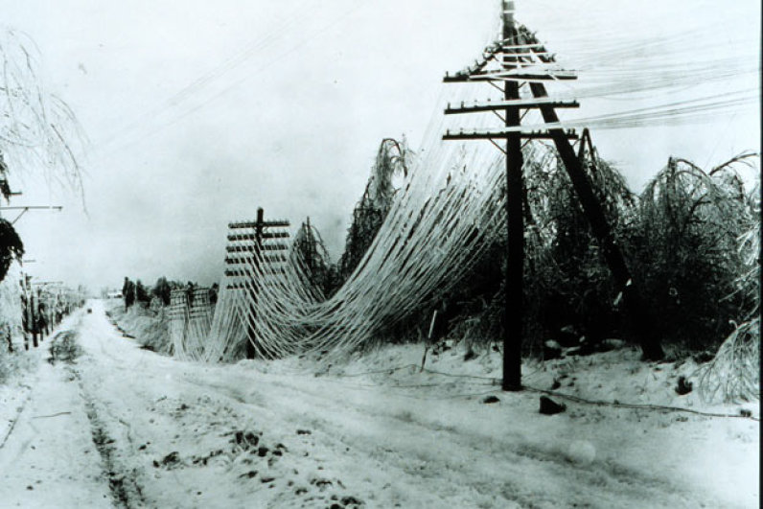
Does This Make A Difference?
Suppose the reason for the delay was that the telegraph lines went down in a storm.
The delay-prevention strategy is expensive: hire more people to check and repair the lines.

Slide 17
Coffee Dealer/Gambler Comparison
Coffee dealer
Large aggregate loss avoided
Low cost precaution
Uniform distribution of risk
Gambler
Large aggregate loss avoided—but in fewer cases
High cost precaution
Uneven distribution of risk high and low
Low risk users subsidize high risk users

Slide 18
In The Snowstorm Example
Was the loss reasonably foreseeably by the party in breach at the time of contracting?
(a) Yes
(b) No

Slide 19
Purposes
(1) to give parties an incentive to take precautions to avoid breaches
Hadley v. Baxendale
Coffee dealer
Horse race
Tony Tenor
(2) to cut off liability
Buck v. Morrow
Chicago flood of 1992

Slide 20
Buck and Morrow
Morrow leased land to Buck. Morrow sells the land before the expiration of the lease. For a year, Buck has to let the cattle graze on a commons, has to hire more help to watch them. He loses cattle, and has to lease more expensive land.
Was the loss reasonably foreseeably by the party in breach at the time of contracting?
(a) Yes
(b) No
(c) Some may be, some not.

Slide 21
An Approach: Information and Control
Information
Who has relevant information?
Control:
Who has control over relevant factors?
The answers help determine who is in the best position to take precautions to prevent the breach.

Slide 22
Best Cost Avoider Approach
Put liability on the person in the best position to take steps to avoid the lost.
Requires:
Information
Control

Slide 23
The Sea Lions
Sea lions sun themselves on the Santa Monica Bell Buoy about a mile off the Santa Monica Pier. A sailboat chartering company, Sail Away and Santa Monica Pier (SMP) enter a contract that says that Sail Away will take SMP visitors to see the sea lions five times a day for a cost to SMP of $100 a trip. Sail Away begins to carry SMP visitors. The mast on the Sail Away boat breaks in half. The accident was not the fault of Sail Away. Sail Away does not have a replacement mast and cannot sail. It sends the broken mast for repair (this is faster than buying a new mast) to Mast Fix, a repair company. It tells Mast Fix that this is a rush job, but it does not tell them why. Mast Fix does know that Sail Away is a charter company. A Mast Fix employee mislays the mast and it takes a month and a week to find it and repair it instead of the one week that Mast Fix said it would take. Assume it is proper mitigation simply to wait for the mast. Sail away loses profits from not being able to sail.
Are Sail Away’s lost profits reasonably foreseeable as a result of the delay.
(a) Yes (b) No

Slide 24
The 1992 Flood
In a breach of contract, a contract put a hole in a tunnel that ran near the river.
It took three days before the flood was cleaned up enough to allow business to begin to resume and cost the city an estimated $1.95 billion in 1992 dollars ($3.5 billion today).
Was the $1.95 ($3.5 billion) loss reasonably foreseeable by the party in breach at the time of contracting?
(a) Yes
(b) No

Slide 25
A Normative Limitation: Mason and Dixon
Mason, Inc. contracts to sell several thousand computer monitors to Dixon and Co. Mason informs Dixon at the time of contracting that Mason is relying on the payments from Dixon to pay Mason’s creditors, and that, if Dixon fails to make the periodic payments on time, Mason will incur substantial late charges and penalties. Dixon fails to pay on time, and Mason incurs late charges.
Was the loss reasonably foreseeably by the party in breach at the time of contracting?
(a) Yes
(b) No

Slide 26
Foreseeability
Have you identified the losses sustained by the properly mitigating non-breacher?
Yes
No
For each item of loss ask, was it (in the ordinary meaning of the words) reasonably foreseeable?
You must do so first
No
Adequate normative justification to impose the loss on the non-breacher?
Adequate normative justification to impose the loss on the breacher?
No
Yes
No
Non-breacher bears loss
Breacher bears the loss
Breacher bears loss
Non-breacher bears loss

